Slide 1


An educational application to help you succeed in your schoolwork.
Team pigeon

Slide 2
Introduction
EFIC
Demo
Windows GUI
Mobile Application
Code
Cloud
Machine Learning

Slide 3
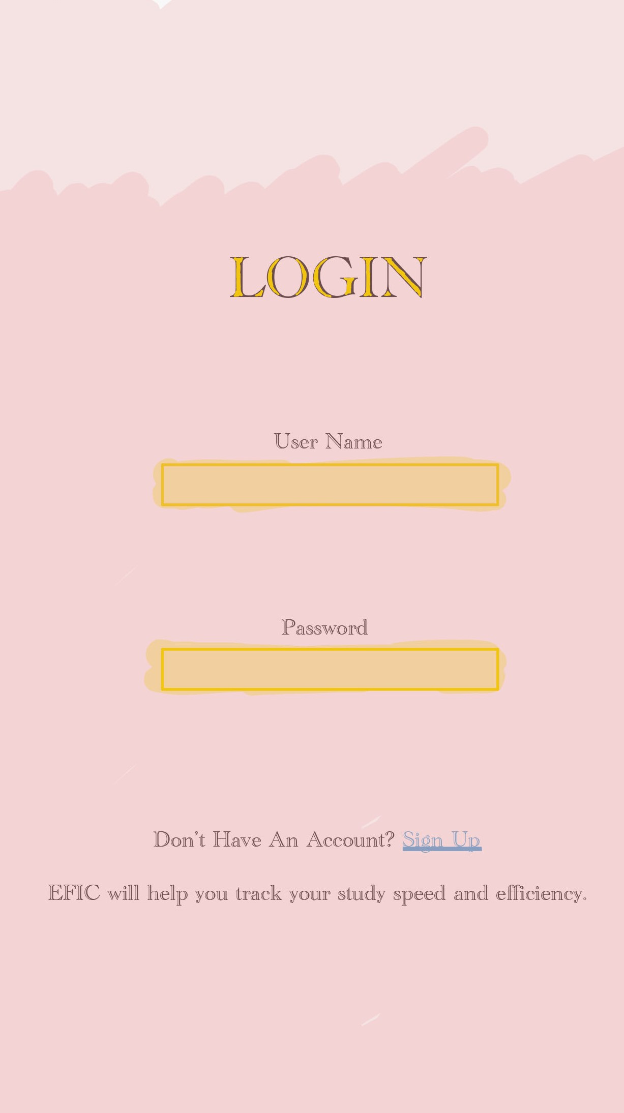
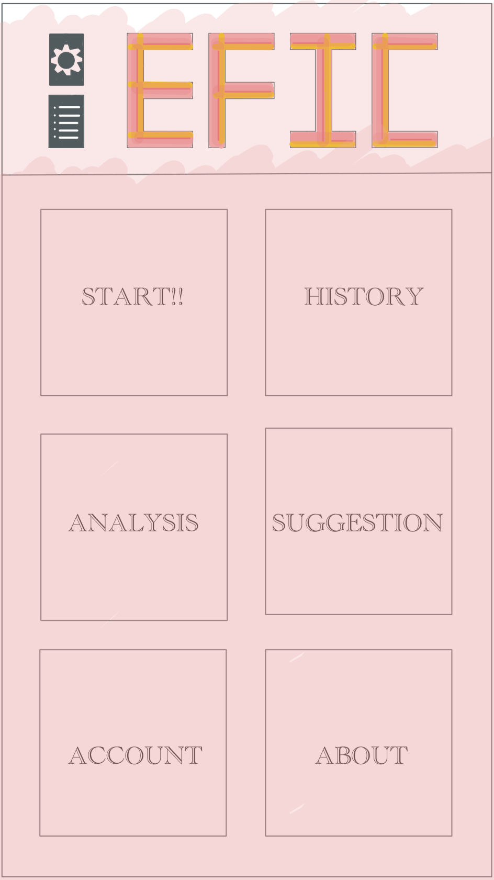

Mobile application Demo

Slide 4
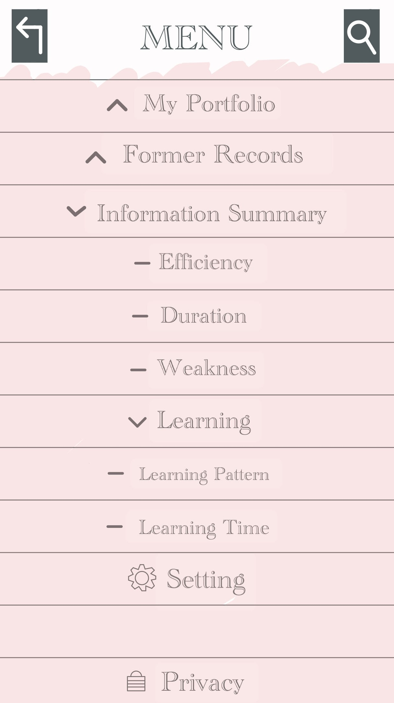
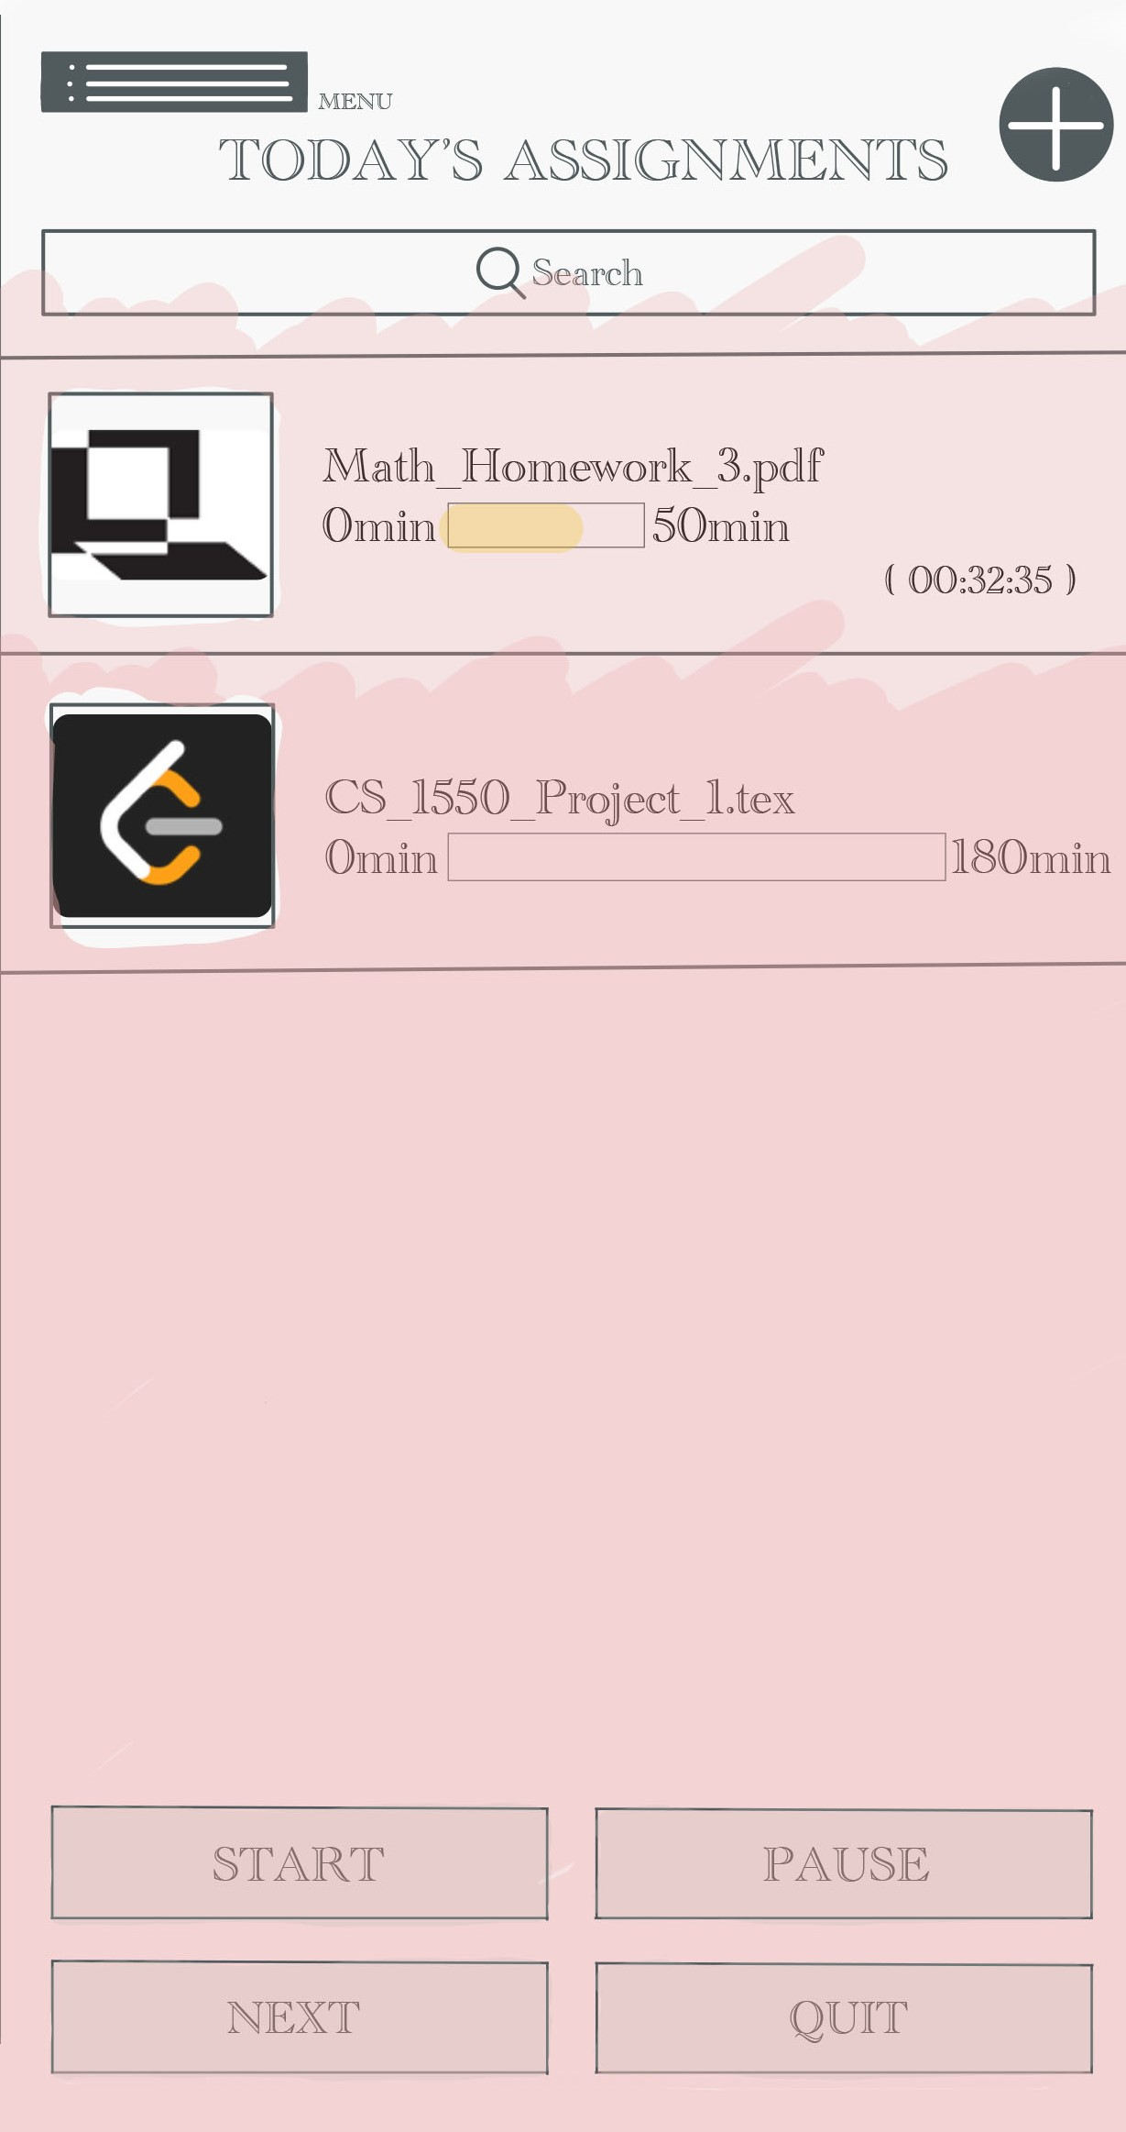
menu & Assignments page
Requiring user provides school name, class, major. These information would help us to trace their study performance.
Requiring the user to upload the homework or practice question. The software would recognize the keywords of questions in order to estimate which subjects, or even the specific area the user is studying. For example, if “merge sort”, “quick sort” appear in the questions several times, the software would recognize that the user is studying data structure.

Slide 5
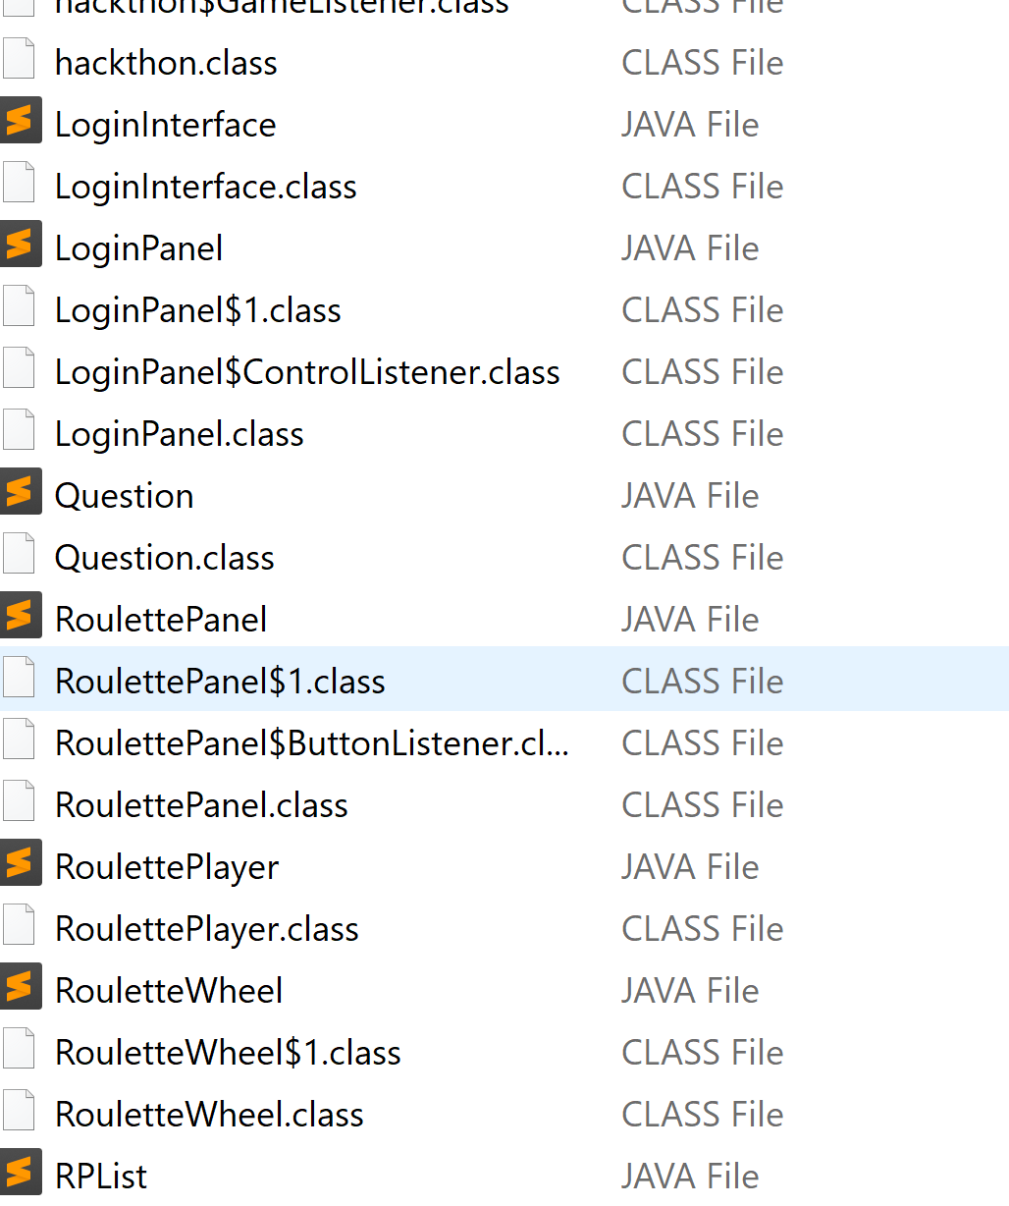
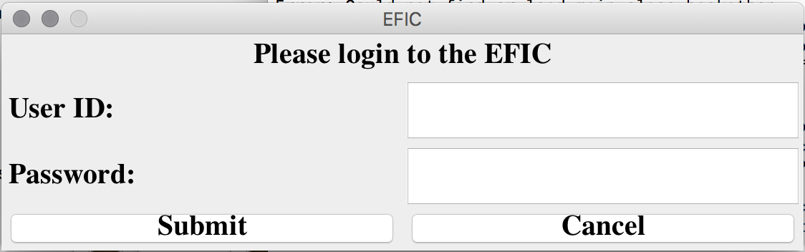
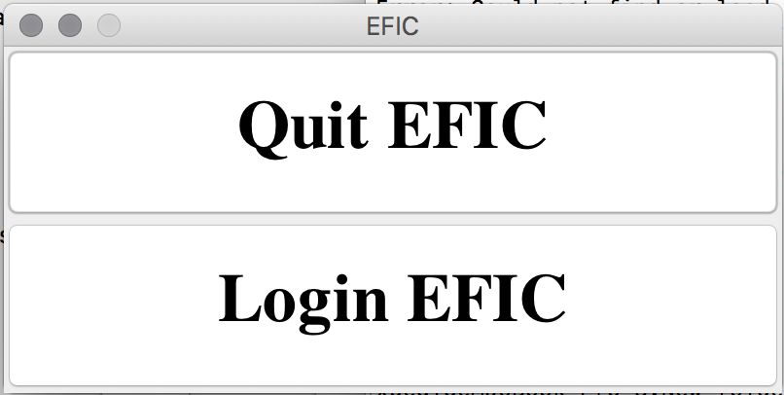
Windows graphic user interface:
<- a portion of our codes
- Examples of our user interface

Slide 6
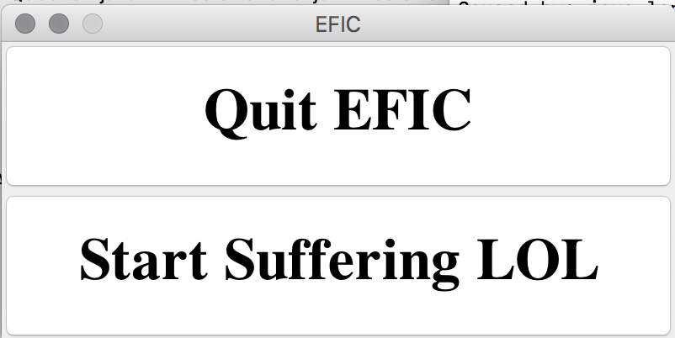
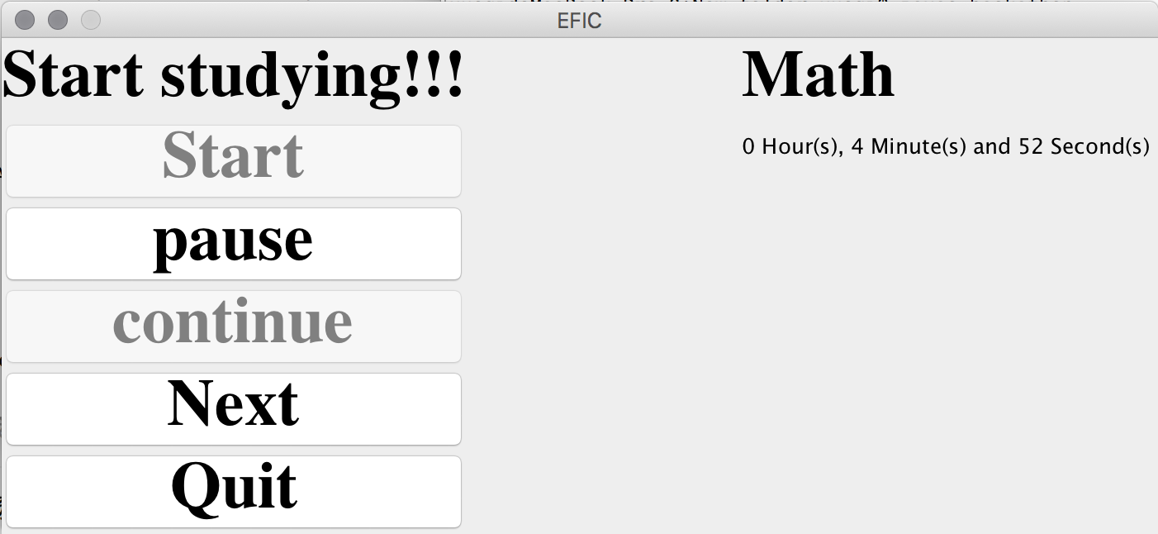

Windows graphic user interface :
A timer to record the time you’ve spent on this homework

Slide 7
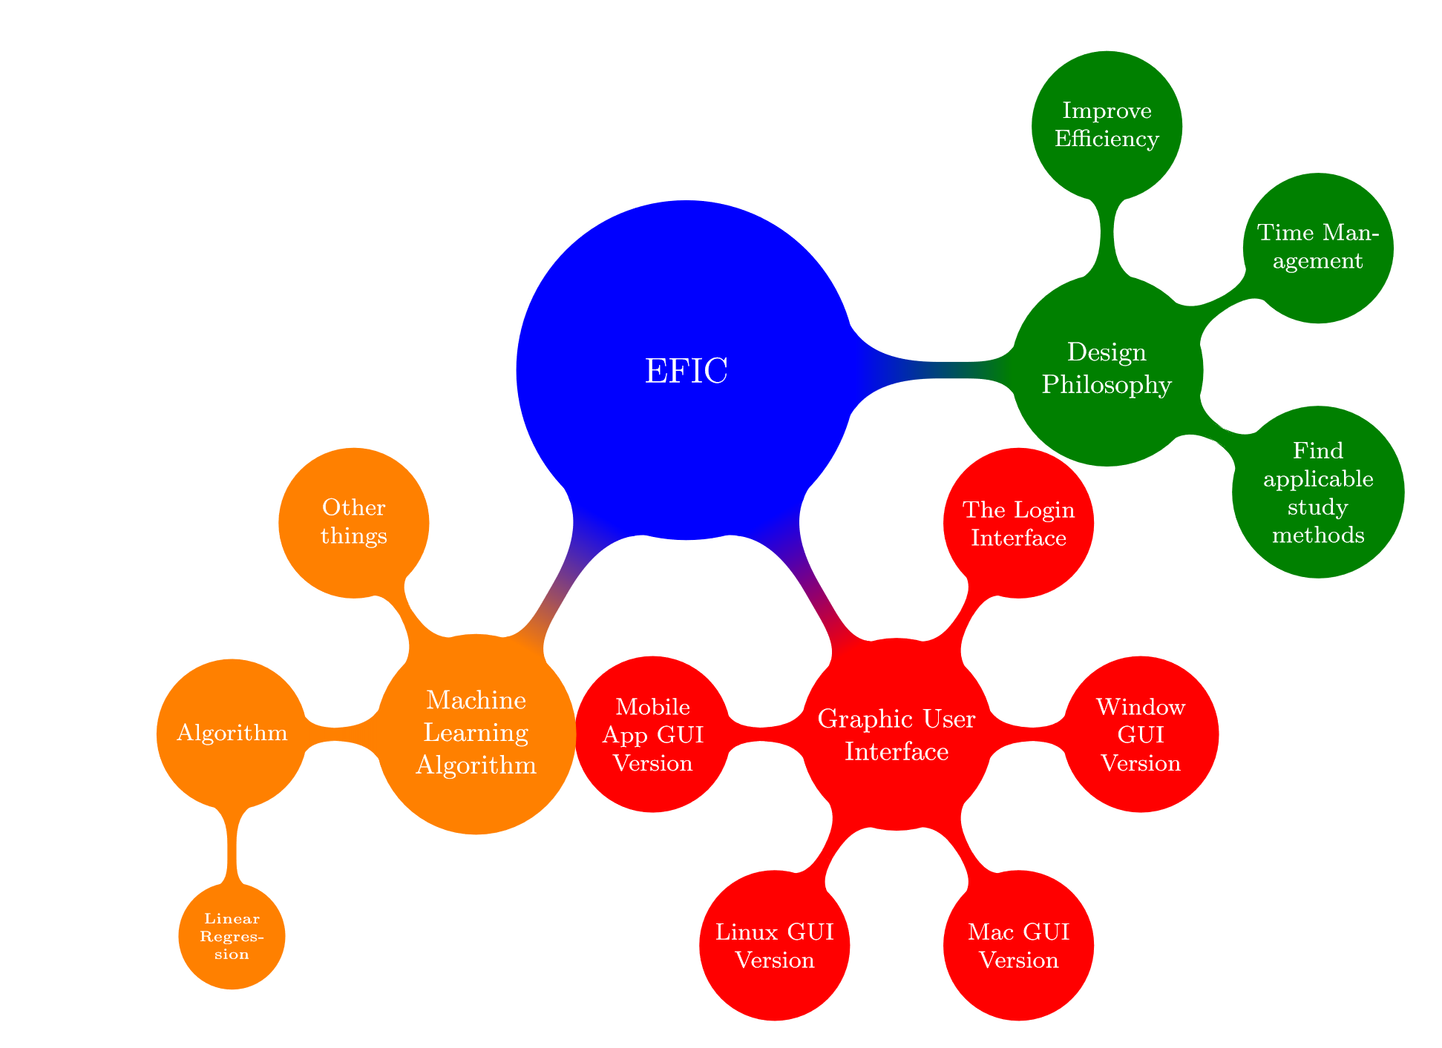
Design philosophy
EFIC is to help you:
Improve efficiency
Find applicable studying method
Be expert in time management
Maximize Competitiveness

Slide 8


features
After user finish studying, he could provide the actual studying time. The software would use the machine learning algorithm to modify the future prediction in order to make the prediction more precise.
Time notification
Base on the data and information that the user provides, the software would predict how much time the user would spend on studying this subject.
Future study time inference

Slide 9
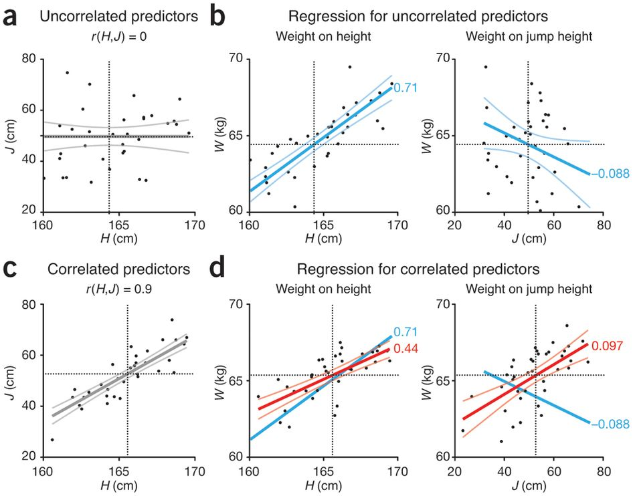
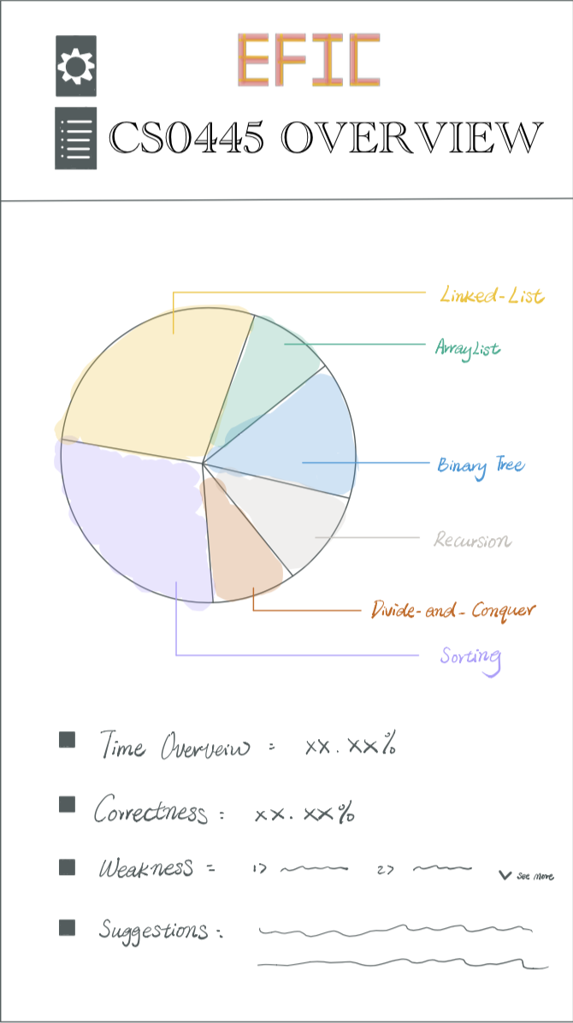
Linear Regression Model

Slide 10
features
After the user finish studying, he can choose the questions that they have problem. The software can recognize the keywords of questions. When the user is doing review, the software can give the alert about the parts he or she should pay attention to.
Studying method analysis
The user can choose whether provide their homework and exam grade. The software can analyze whether the user should change their studying method by machine learning algorithm.
Targeting where your abilities lack

Slide 11

Thank you!
An educational application to help you succeed in homework.
Qi xue, haoxuan cui,
yuanzhe huang, Meizhen ji
University of pittsburgh
Team Pigeon

